Slide 1
MODULE 2 Web Crawling

Slide 2
Outline
•
•
•
•
•
•
•
Motivation and taxonomy of crawlers Basic crawlers and implementation issues Universal crawlers
Preferential (focused and topical) crawlers Evaluation of preferential crawlers Crawler ethics and conflicts
New developments: social, collaborative, federated crawlers

Slide 3
Many names
Crawler
Spider
Robot (or bot)
Web agent
Wanderer, worm, …
And famous instances: googlebot, scooter, slurp, msnbot, …

Slide 4
Motivation for crawlers
Support universal search engines (Google, Yahoo, MSN/Windows Live, Ask, etc.)
Vertical (specialized) search engines, e.g. news, shopping, papers, recipes, reviews, etc.
Business intelligence: keep track of potential competitors, partners
Monitor Web sites of interest
Evil: harvest emails for spamming, phishing…
… Can you think of some others?…

Slide 5
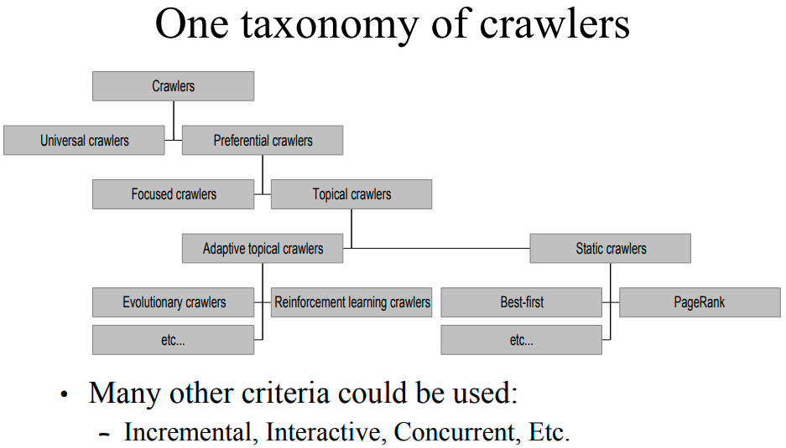

Slide 6
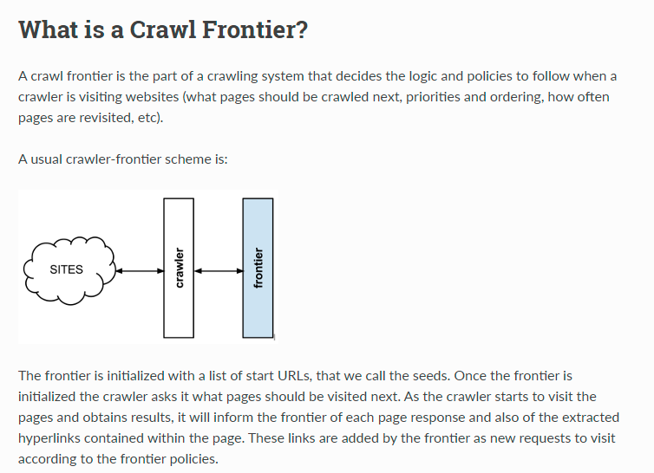

Slide 7
Outline
•
•
•
•
•
•
•
Motivation and taxonomy of crawlers Basic crawlers and implementation issues Universal crawlers
Preferential (focused and topical) crawlers Evaluation of preferential crawlers Crawler ethics and conflicts
New developments: social, collaborative, federated crawlers

Slide 8
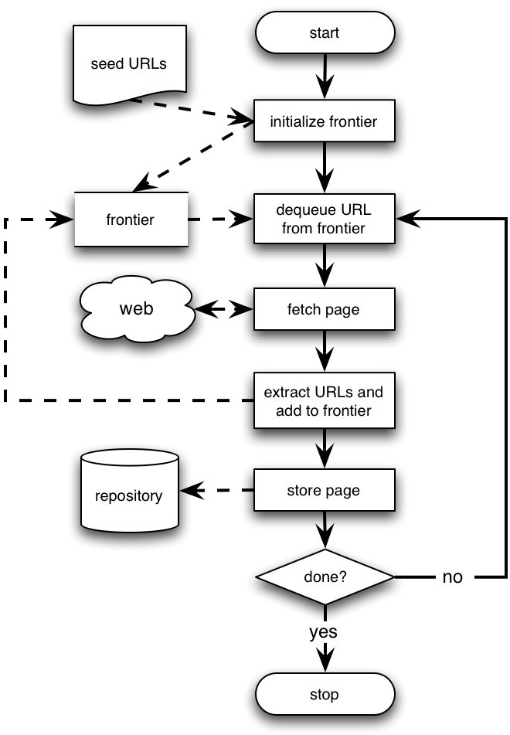
Basic crawlers
•
•
•
This is a sequential crawler
Seeds can be any list of starting URLs
Order of page visits is determined by frontier data structure
Stop criterion can be anything
•

Slide 9
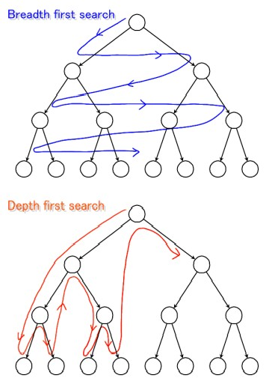
Graph traversal (BFS or DFS?)
•
Breadth First Search
–
–
–
Implemented with QUEUE (FIFO) Finds pages along shortest paths
If we start with “good” pages, this keeps us close; maybe other good stuff…
•
Depth First Search
–
–
Implemented with STACK (LIFO) Wander away (“lost in cyberspace”)

Slide 10
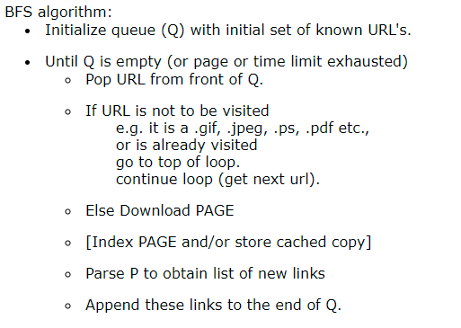
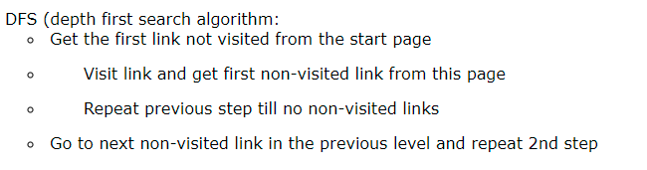

Slide 11
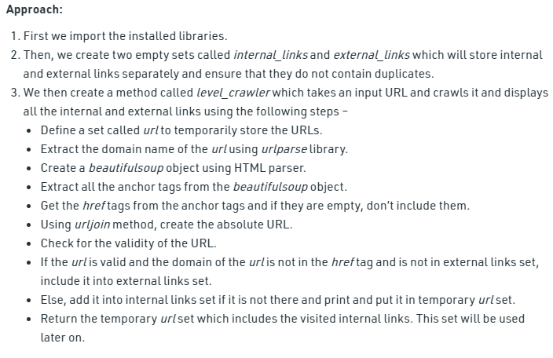

Slide 12
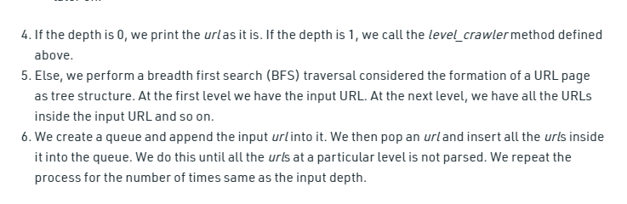

Slide 13
Implementation issues
•
Don’t want to fetch same page twice!
–
–
Keep lookup table (hash) of visited pages What if not visited but in frontier already?
•
•
The frontier grows very fast!
– May need to prioritize for large crawls
Fetcher must be robust!
–
–
Don’t crash if download fails Timeout mechanism
•
Determine file type to skip unwanted files
–
–
Can try using extensions, but not reliable
Can issue ‘HEAD’ HTTP commands to get Content-Type (MIME) headers, but overhead of extra Internet requests

Slide 14
More implementation issues
Fetching
Get only the first 10-100 KB per page
Take care to detect and break redirection loops
Soft fail for timeout, server not responding, file not found, and other errors

Slide 15
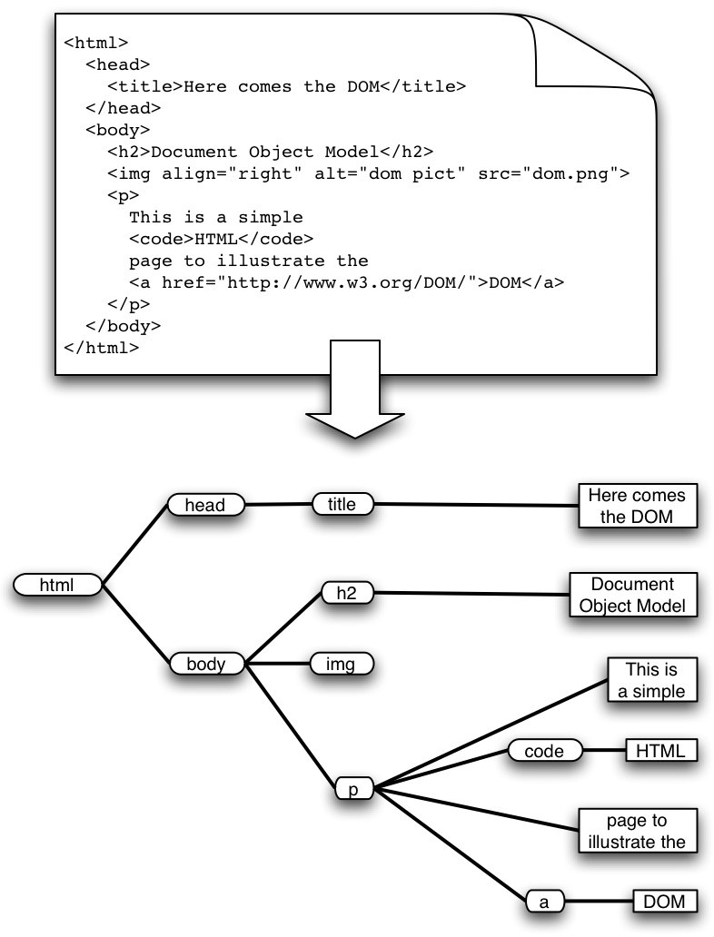
More implementation issues: Parsing
•
•
•
•
•
•
HTML has the structure of a DOM (Document Object Model) tree
Unfortunately actual HTML is often incorrect in a strict syntactic sense
Crawlers, like browsers, must be robust/forgiving
Fortunately there are tools that can help
E.g. tidy.sourceforge.net
Must pay attention to HTML entities and unicode in text
What to do with a growing number of other formats?
Flash, SVG, RSS, AJAX…

Slide 16
More implementation issues
•
Stop words
–
–
–
–
–
Noise words that do not carry meaning should be eliminated (“stopped”) before they are indexed
E.g. in English: AND, THE, A, AT, OR, ON, FOR, etc… Typically syntactic markers
Typically the most common terms Typically kept in a negative dictionary
10–1,000 elements
E.g. http://ir.dcs.gla.ac.uk/resources/linguistic_utils/stop_words
Parser can detect these right away and disregard them
–

Slide 17
More implementation issues
Conflation and thesauri
Idea: improve recall by merging words with same meaning
3. We want to ignore superficial morphological features, thus merge semantically similar tokens
•
–
{student, study, studying, studious} => studi
4. We can also conflate synonyms into a single form using a thesaurus
–
–
–
30-50% smaller index
Doing this in both pages and queries allows to retrieve pages about ‘automobile’ when user asks for ‘car’
Thesaurus can be implemented as a hash table

Slide 18
More implementation issues
Stemming
Morphological conflation based on rewrite rules
Language dependent!
Porter stemmer very popular for English
http://www.tartarus.org/~martin/PorterStemmer/
Context-sensitive grammar rules, eg:
– “IES” except (“EIES” or “AIES”) --> “Y”
Versions in Perl, C, Java, Python, C#, Ruby, PHP, etc.
Porter has also developed Snowball, a language to create stemming algorithms in any language
http://snowball.tartarus.org/
Ex. Perl modules: Lingua::Stem and Lingua::Stem::Snowball
–

Slide 19
More implementation issues
Static vs. dynamic pages
–
–
Is it worth trying to eliminate dynamic pages and only index static pages?
Examples:
http://www.census.gov/cgi-bin/gazetteer
http://informatics.indiana.edu/research/colloquia.asp
http://www.amazon.com/exec/obidos/subst/home/home.html/002-8332429-6490452
http://www.imdb.com/Name?Menczer,+Erico
http://www.imdb.com/name/nm0578801/
–
–
Why or why not? How can we tell if a page is dynamic? What about ‘spider traps’?
What do Google and other search engines do?

Slide 20
More implementation issues
Relative vs. Absolute URLs
Crawler must translate relative URLs into absolute URLs
Need to obtain Base URL from HTTP header, or HTML Meta tag, or else current page path by default
Examples
Base: http://www.cnn.com/linkto/
Relative URL: intl.html
Absolute URL: http://www.cnn.com/linkto/intl.html
Relative URL: /US/
Absolute URL: http://www.cnn.com/US/

Slide 21
More implementation issues
URL canonicalization
All of these:
http://www.cnn.com/TECH
http://WWW.CNN.COM/TECH/
http://www.cnn.com:80/TECH/
http://www.cnn.com/bogus/../TECH/
Are really equivalent to this canonical form:
http://www.cnn.com/TECH/
In order to avoid duplication, the crawler must transform all URLs into canonical form
Definition of “canonical” is arbitrary, e.g.:
Could always include port
Or only include port when not default :80

Slide 22
More implementation issues
Spider traps
Misleading sites: indefinite number of pages dynamically generated by CGI scripts
Paths of arbitrary depth created using soft directory links and path rewriting features in HTTP server
Only heuristic defensive measures:
Check URL length; assume spider trap above some threshold, for example 128 characters
Watch for sites with very large number of URLs
Eliminate URLs with non-textual data types
May disable crawling of dynamic pages, if can detect

Slide 23
More implementation issues
•
Page repository
Naïve: store each page as a separate file
Can map URL to unique filename using a hashing function, e.g. MD5
This generates a huge number of files, which is inefficient from the storage perspective
Better: combine many pages into a single large file, using some XML markup to separate and identify them
Must map URL to {filename, page_id}
Database options
Any RDBMS -- large overhead
Light-weight, embedded databases such as Berkeley DB
–
–

Slide 24
Concurrency
A crawler incurs several delays:
Resolving the host name in the URL to an IP address using DNS
Connecting a socket to the server and sending the request
Receiving the requested page in response
Solution: Overlap the above delays by fetching many pages concurrently

Slide 25
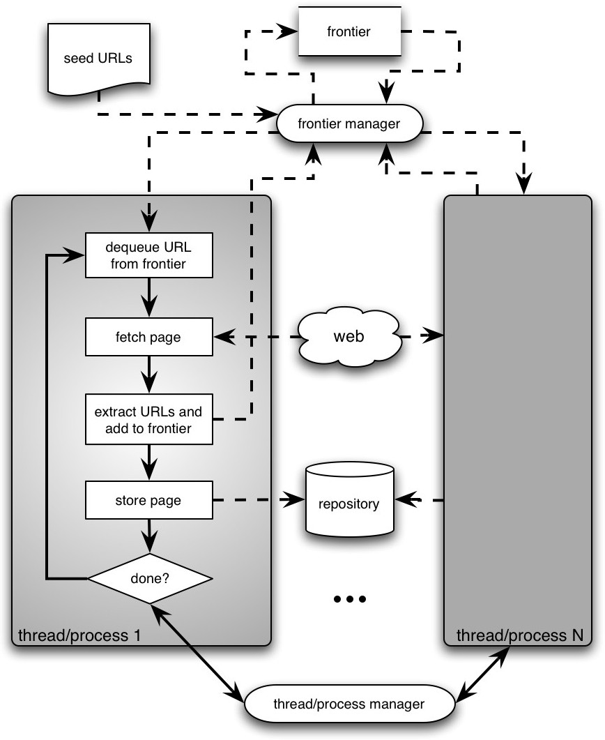
Architecture of a concurrent crawler

Slide 26
Concurrent crawlers
Can use multi-processing or multi-threading
Each process or thread works like a sequential crawler, except they share data structures: frontier and repository
Shared data structures must be synchronized (locked for concurrent writes)
Speedup of factor of 5-10 are easy this way

Slide 27
Outline
•
•
•
•
•
•
•
Motivation and taxonomy of crawlers Basic crawlers and implementation issues Universal crawlers
Preferential (focused and topical) crawlers Evaluation of preferential crawlers Crawler ethics and conflicts
New developments: social, collaborative, federated crawlers

Slide 28
Universal crawlers
Support universal search engines
Large-scale
Huge cost (network bandwidth) of crawl is amortized over many queries from users
Incremental updates to existing index and other data repositories

Slide 29
Large-scale universal crawlers
•
•
Two major issues: Performance
Need to scale up to billions of pages Policy
Need to trade-off coverage, freshness, and bias (e.g. toward “important” pages)
•

Slide 30
Large-scale crawlers: scalability
Need to minimize overhead of DNS lookups
Need to optimize utilization of network bandwidth and disk throughput (I/O is bottleneck)
Use asynchronous sockets
Multi-processing or multi-threading do not scale up to billions of pages
Non-blocking: hundreds of network connections open simultaneously
Polling socket to monitor completion of network transfers

Slide 31
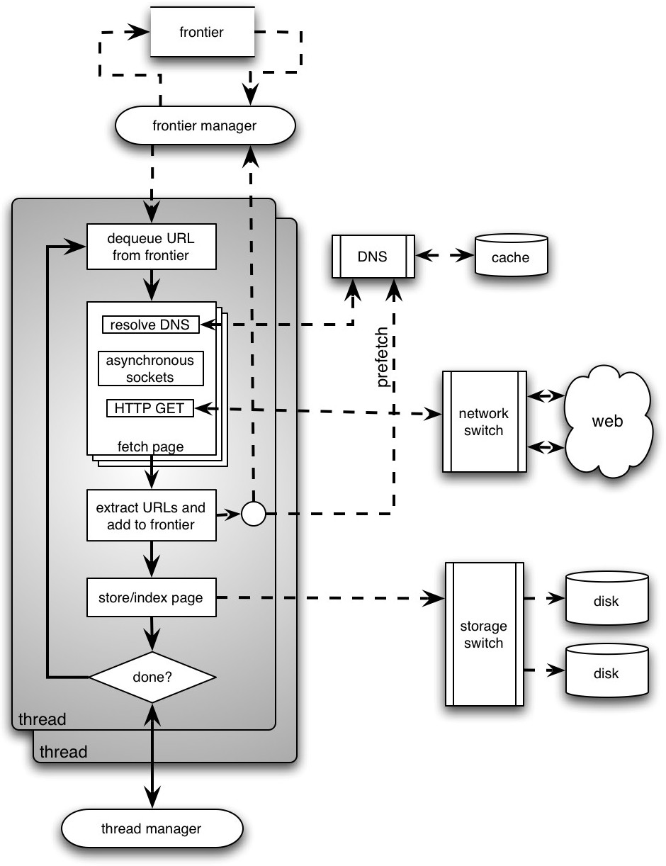
Several parallel queues to spread load across servers (keep connections alive)
DNS server using UDP (less overhead than TCP), large persistent in-memory cache, and prefetching
High-level architecture of a scalable universal crawler
Optimize use of network bandwidth
Huge farm of crawl machines
Optimize disk I/O throughput

Slide 32
Universal crawlers: Policy
Coverage
New pages get added all the time
Can the crawler find every page?
Freshness
Pages change over time, get removed, etc.
How frequently can a crawler revisit ?
Trade-off!
Focus on most “important” pages (crawler bias)?
“Importance” is subjective

Slide 33
Maintaining a “fresh” collection
Universal crawlers are never “done”
High variance in rate and amount of page changes
HTTP headers are notoriously unreliable
Last-modified
Expires
Solution
Estimate the probability that a previously visited page has changed in the meanwhile
Prioritize by this probability estimate

Slide 34
Estimating page change rates
Algorithms for maintaining a crawl in which most pages are fresher than a specified epoch
Brewington & Cybenko; Cho, Garcia-Molina & Page
Assumption: recent past predicts the future (Ntoulas, Cho & Olston 2004)
Frequency of change not a good predictor
Degree of change is a better predictor

Slide 35
Do we need to crawl the entire Web?
•
•
•
•
If we cover too much, it will get stale There is an abundance of pages in the Web
For PageRank, pages with very low prestige are largely useless
What is the goal?
–
–
–
General search engines: pages with high prestige News portals: pages that change often
Vertical portals: pages on some topic
•
What are appropriate priority measures in these cases? Approximations?

Slide 36
Outline
•
•
•
•
•
•
•
Motivation and taxonomy of crawlers Basic crawlers and implementation issues Universal crawlers
Preferential (focused and topical) crawlers Evaluation of preferential crawlers Crawler ethics and conflicts
New developments: social, collaborative, federated crawlers

Slide 37
Preferential crawlers
•
•
•
•
Assume we can estimate for each page an importance measure, I(p)
Want to visit pages in order of decreasing I(p) Maintain the frontier as a priority queue sorted by I(p) Possible figures of merit:
–
–
Precision ~
| p: crawled(p) & I(p) > threshold | / | p: crawled(p) |
Recall ~
| p: crawled(p) & I(p) > threshold | / | p: I(p) > threshold |

Slide 38
Preferential crawlers
•
Selective bias toward some pages, eg. most “relevant”/topical, closest to seeds, most popular/largest PageRank, unknown servers, highest rate/amount of change, etc…
Focused crawlers
– Supervised learning: classifier based on labeled examples
Topical crawlers
•
•
–
–
Best-first search based on similarity(topic, parent) Adaptive crawlers
Reinforcement learning
Evolutionary algorithms/artificial life

Slide 39
Preferential crawling algorithms: Examples
•
Breadth-First
– Exhaustively visit all links in order encountered
Best-N-First
•
–
–
Priority queue sorted by similarity, explore top N at a time Variants: DOM context, hub scores
•
•
PageRank
– Priority queue sorted by keywords, PageRank
SharkSearch
– Priority queue sorted by combination of similarity, anchor text, similarity of parent, etc. (powerful cousin of FishSearch)
•
InfoSpiders
– Adaptive distributed algorithm using an evolving population of learning agents

Slide 40
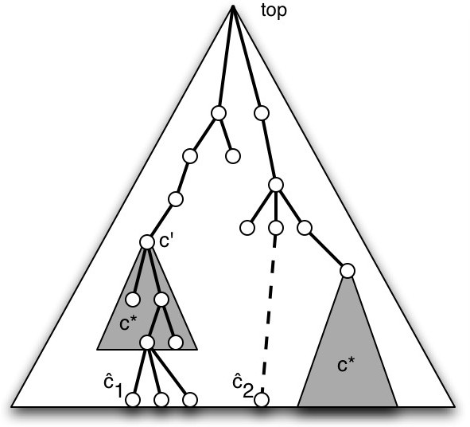
Focused crawlers: Basic idea
•
Naïve-Bayes classifier based on example pages in desired topic, c*
Score(p) = Pr(c*|p)
•
–
–
Soft focus: frontier is priority queue using page score
Hard focus:
Find best leaf ĉ for p
If an ancestor c’ of ĉ is in c* then add links from p to frontier, else discard
Soft and hard focus work equally well empirically
–
Example: Open Directory

Slide 41
Focused crawlers
•
•
•
•
Can have multiple topics with as many classifiers, with scores appropriately combined (Chakrabarti et al. 1999)
Can use a distiller to find topical hubs periodically, and add these to the frontier
Can accelerate with the use of a critic (Chakrabarti et al. 2002)
Can use alternative classifier algorithms to naïve-Bayes, e.g. SVM and neural nets have reportedly performed better (Pant & Srinivasan 2005)

Slide 42
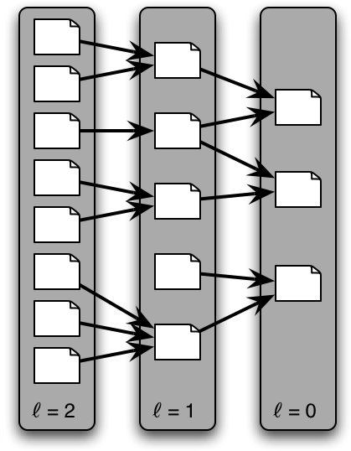
Context-focused crawlers
Same idea, but multiple classes (and classifiers) based on link distance from relevant targets
ℓ=0 is topic of interest
ℓ=1 link to topic of interest
– Etc.
•
Initially needs a back-crawl from seeds (or known targets) to train classifiers to estimate distance
Links in frontier prioritized based on estimated distance from targets
Outperforms standard focused crawler empirically
•
•
Context graph

Slide 43
Topical crawlers
All we have is a topic (query, description, keywords) and a set of seed pages (not necessarily relevant)
No labeled examples
Must predict relevance of unvisited links to prioritize
Original idea: Menczer 1997, Menczer & Belew 1998

Slide 44
Topical locality
Topical locality is a necessary condition for a topical crawler to work, and for surfing to be a worthwhile activity for humans
Links must encode semantic information, i.e. say something about neighbor pages, not be random
It is also a sufficient condition if we start from “good” seed pages Indeed we know that Web topical locality is strong :
Indirectly (crawlers work and people surf the Web)
From direct measurements (Davison 2000; Menczer 2004, 2005)

Slide 45
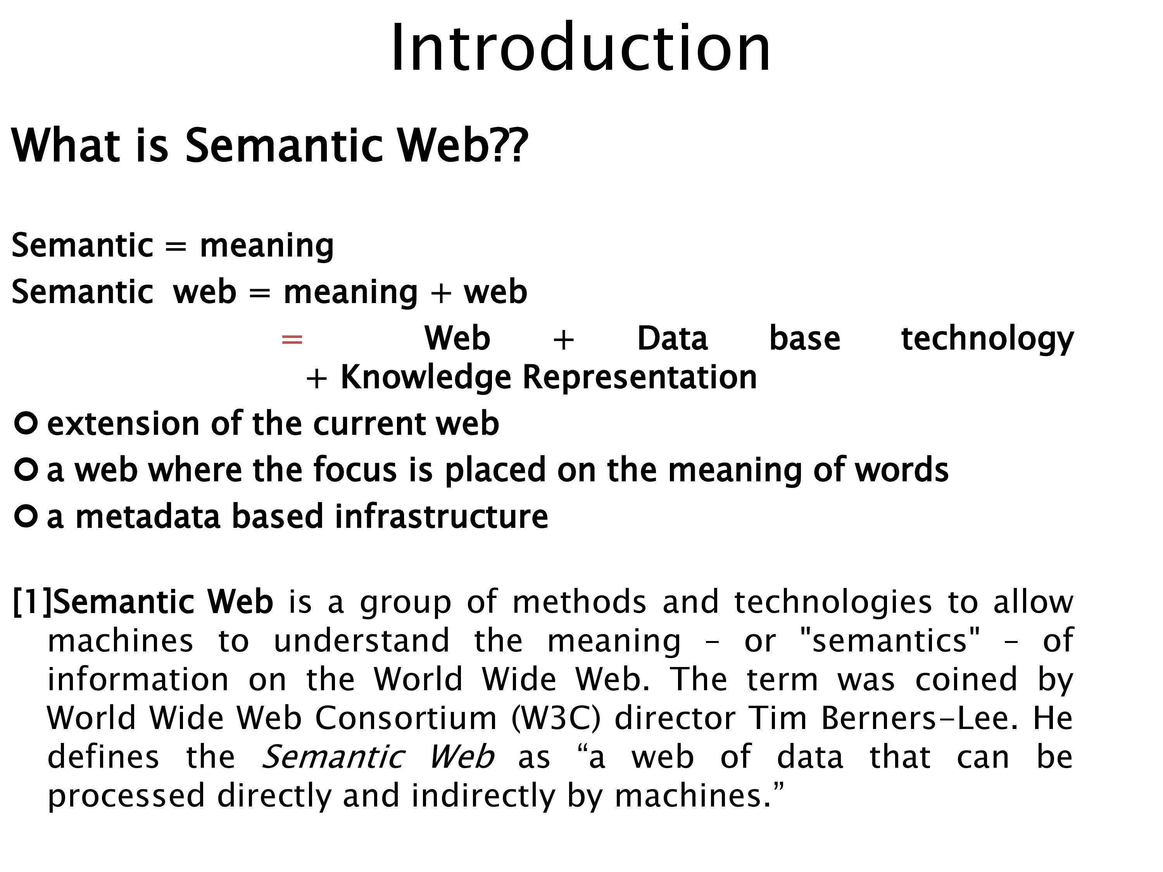

Slide 46
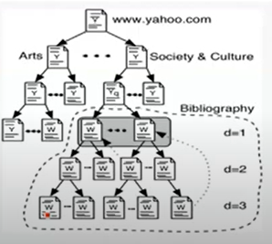
Quantifying topical locality
•
Different ways to pose the question:
–
–
–
How quickly does semantic locality decay?
How fast is topic drift?
How quickly does content change as we surf away from a starting page?
•
To answer these questions, let us consider exhaustive breadth-first crawls from 100 topic pages

Slide 47
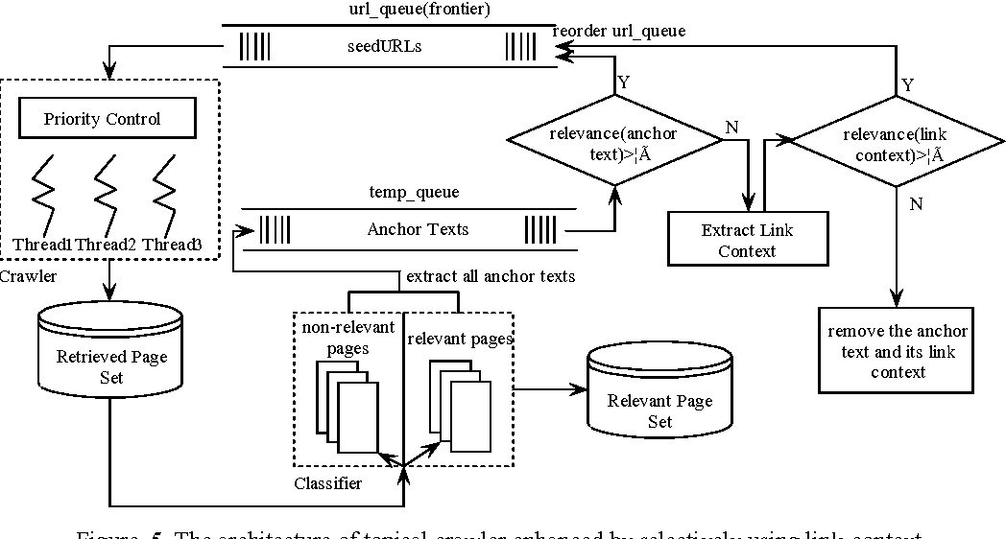
Topical web crawling for domain-specific resource discovery enhanced by selectively using link-context

Slide 48
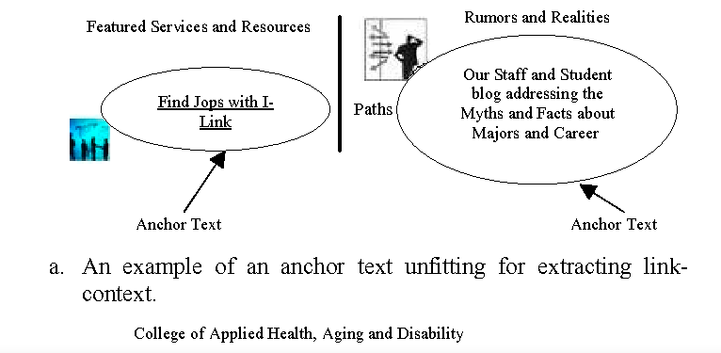
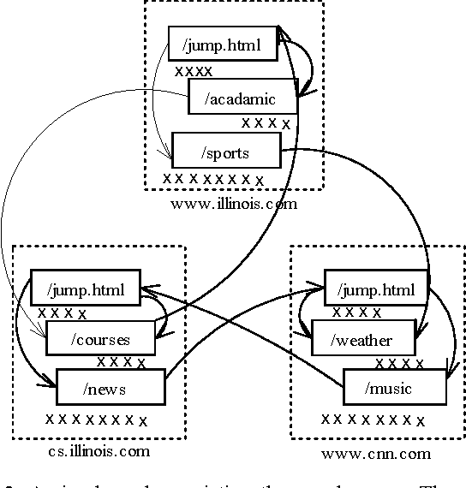

Slide 49
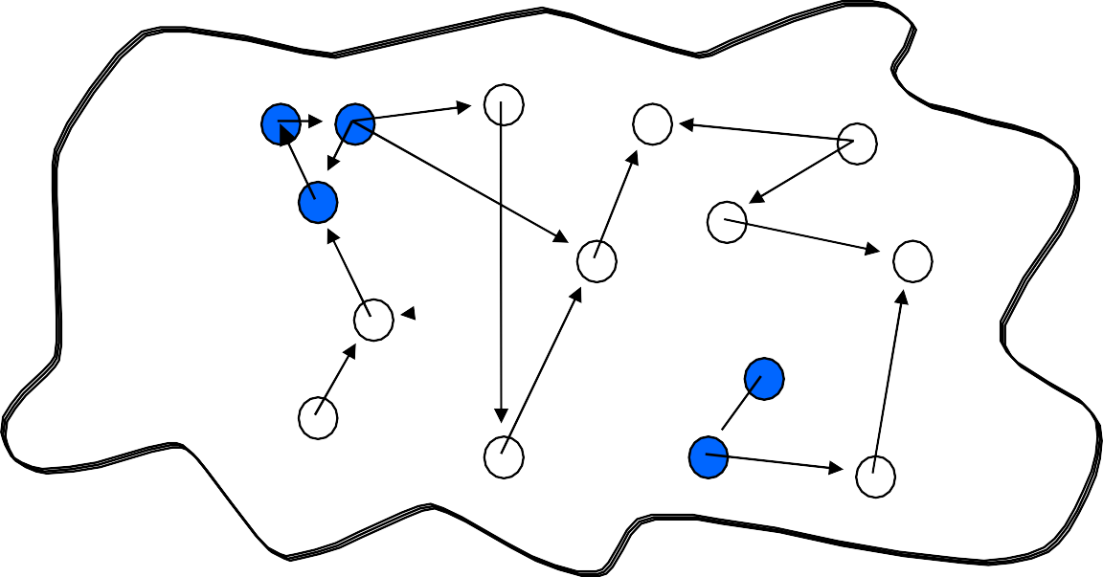
The “link-cluster” conjecture
•
Connection between semantic topology (relevance) and link topology (hypertext)
– G = Pr[rel(p)] ~ fraction of relevant/topical pages (topic generality)
R = Pr[rel(p) | rel(q) AND link(q,p)] ~ cond. prob. Given neighbor on topic
–
•
Related nodes are clustered if R > G
–
Necessary and sufficient condition for a random crawler
to find pages related to start points
Example:
2 topical clusters with stronger modularity within
each cluster than outside
–

Slide 50
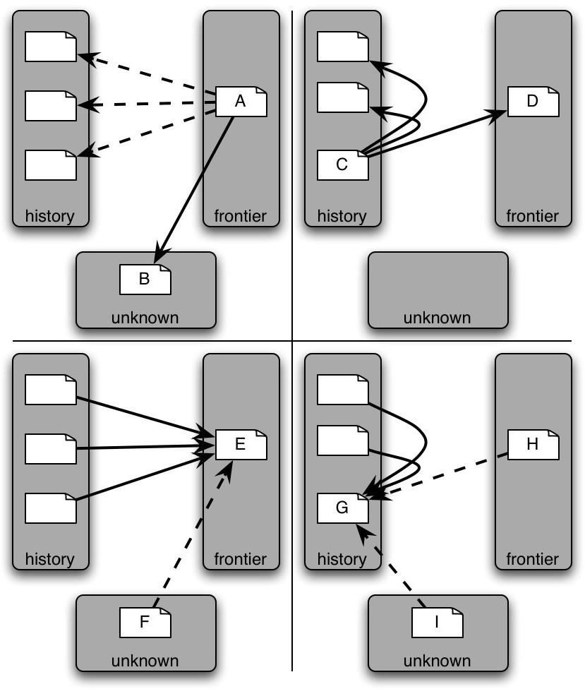
Topical locality-inspired tricks for topical crawlers
Co-citation (a.k.a. sibling locality): A and C are good hubs, thus A and D should be given high priority
Co-reference (a.k.a. blbliographic coupling):
E and G are good authorities, thus E and H should be given high priority
•

Slide 51
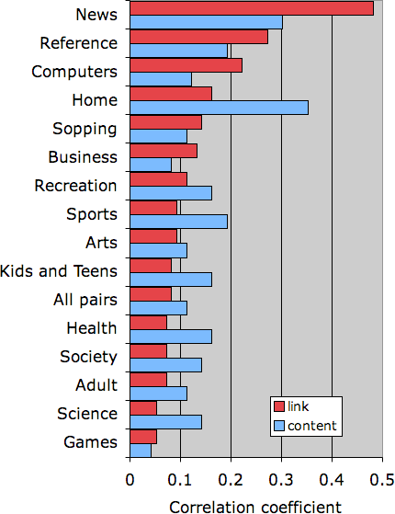
Correlations between different similarity measures
•
Semantic similarity measured from ODP, correlated with:
–
–
Content similarity: TF or TF-IDF vector cosine
Link similarity: Jaccard coefficient of (in+out) link neighborhoods
•
•
Correlation overall is significant but weak
Much stronger topical locality in some topics, e.g.:
–
–
Links very informative in news sources Text very informative in recipes

Slide 52
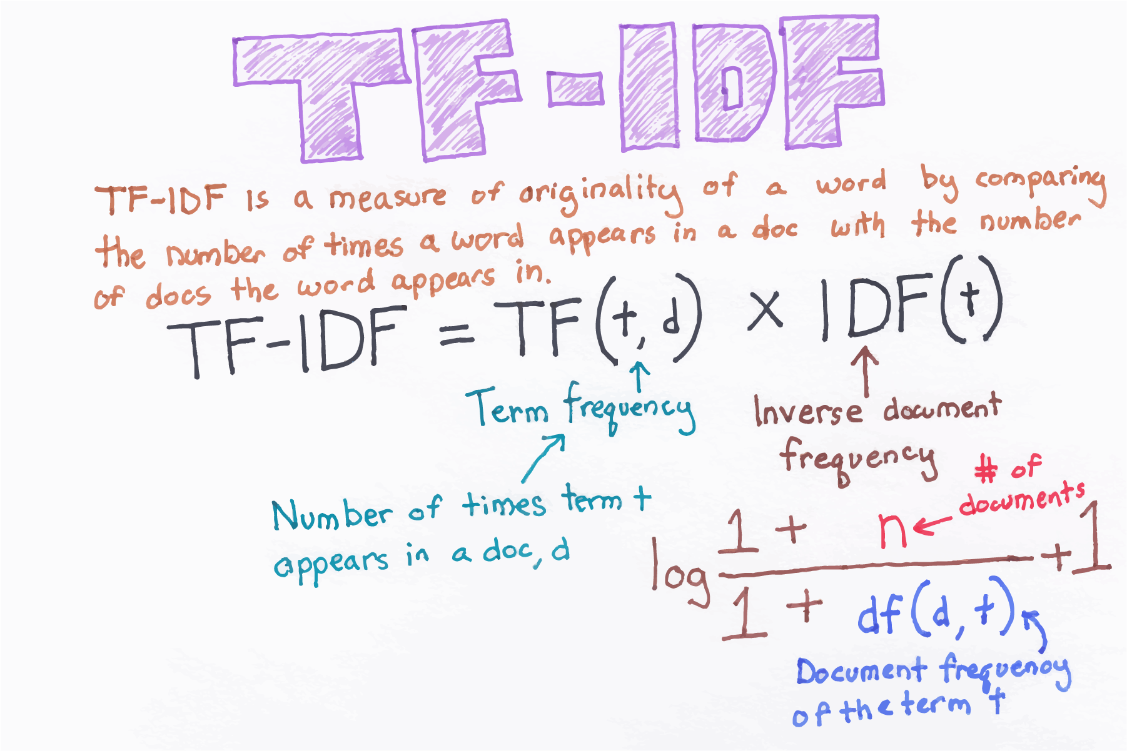

Slide 53
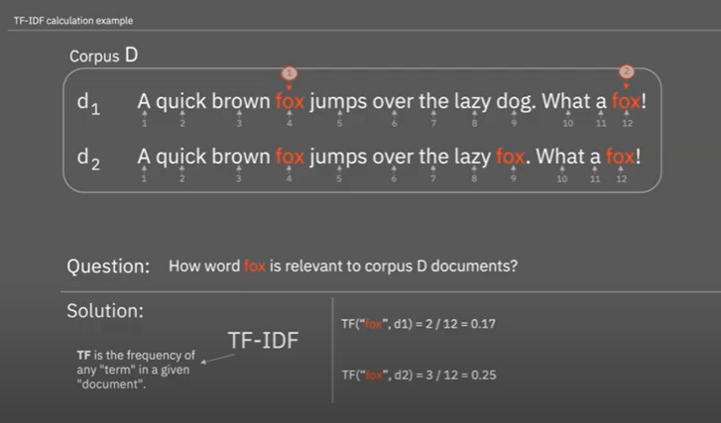

Slide 54
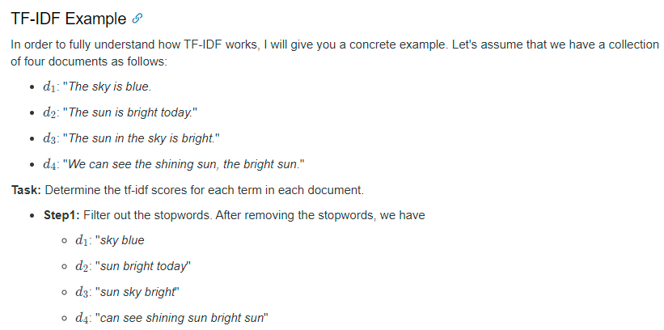

Slide 55
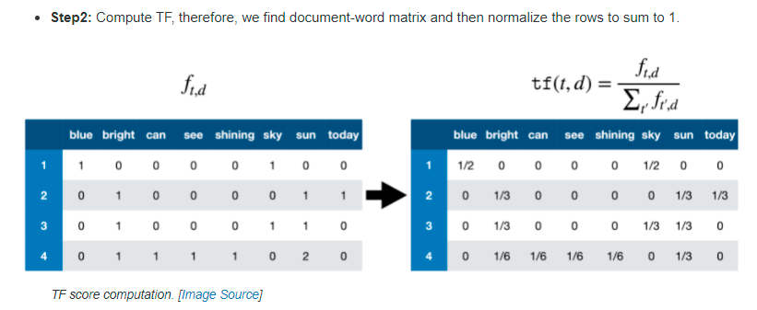
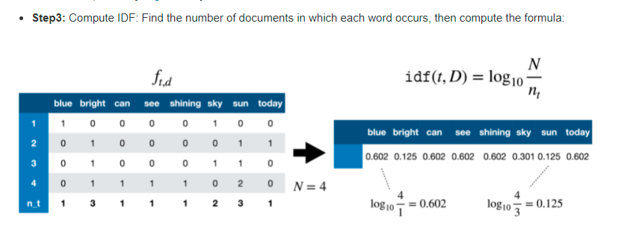

Slide 56
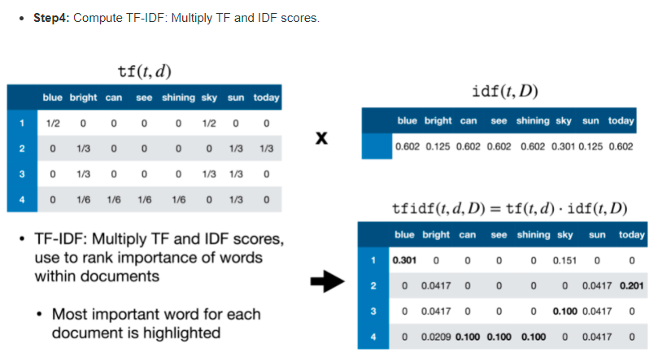

Slide 57
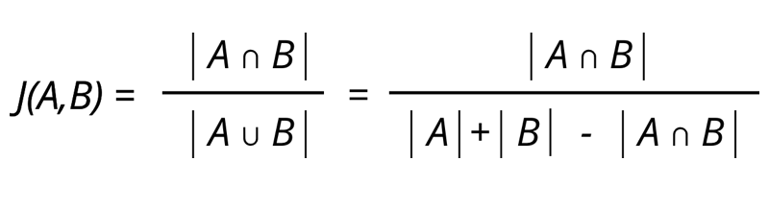
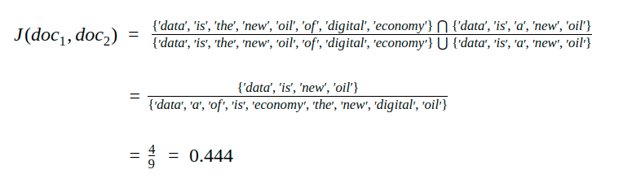
Jaccard Similarity

Slide 58
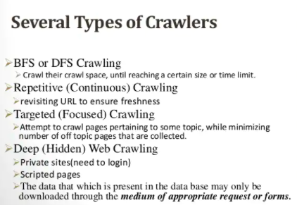

Slide 59
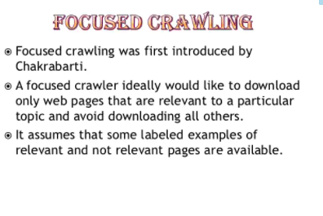

Slide 60
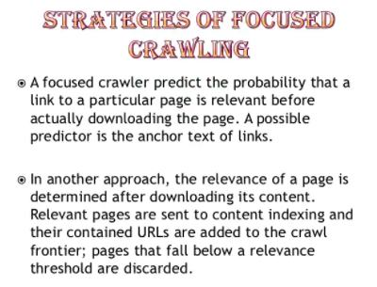

Slide 61
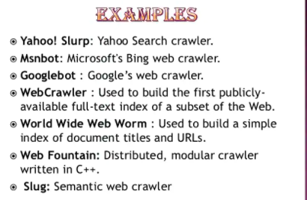

Slide 62
Naïve Best-First
BestFirst(topic, seed_urls) { foreach link (seed_urls) {
enqueue(frontier, link);
}
while (#frontier > 0 and visited < MAX_PAGES) { link := dequeue_link_with_max_score(frontier); doc := fetch_new_document(link);
Simplest topical crawler: Frontier is priority queue based on text similarity between topic and parent page
score := sim(topic, doc);
foreach outlink (extract_links(doc)) { if (#frontier >= MAX_BUFFER) {
dequeue_link_with_min_score(frontier);
}
enqueue(frontier, outlink, score);
}
}
}

Slide 63
Best-first variations
Many in literature, mostly stemming from different ways to score unvisited URLs. E.g.:
Giving more importance to certain HTML markup in parent page
Extending text representation of parent page with anchor text from “grandparent” pages (SharkSearch)
Limiting link context to less than entire page
Exploiting topical locality (co-citation)
Exploration vs exploitation: relax priorities
Any of these can be (and many have been) combined

Slide 64
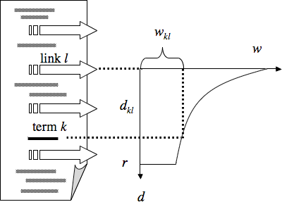
Link context based on text neighborhood
•
Often consider a fixed- size window, e.g. 50 words around anchor
Can weigh links based on their distance from topic keywords within the document (InfoSpiders, Clever)
Anchor text deserves extra importance
•
•

Slide 65
Link context based on DOM tree
•
•
Consider DOM subtree rooted at parent node of link’s <a> tag
Or can go further up in the tree (Naïve Best-First is special case of entire document body)
Trade-off between noise due to too small or too large context tree (Pant 2003)

Slide 66
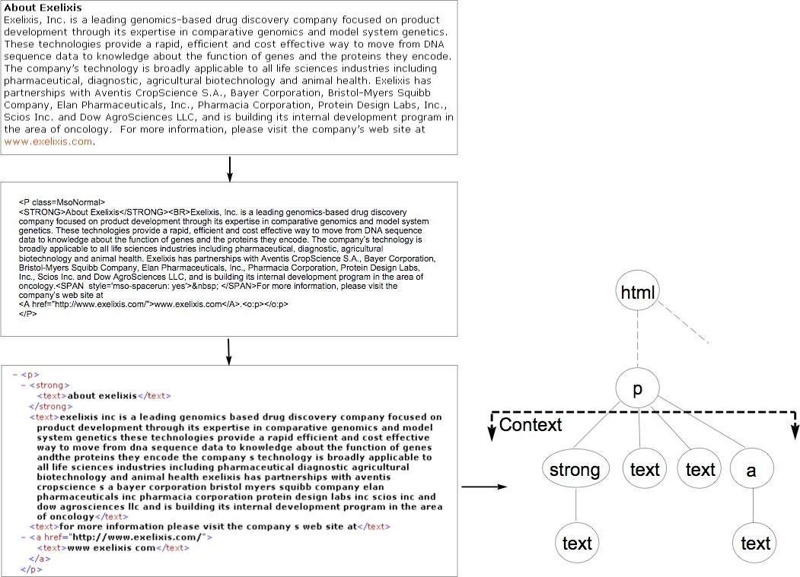
DOM context
Link score = linear combination between page-based and context- based similarity score

Slide 67
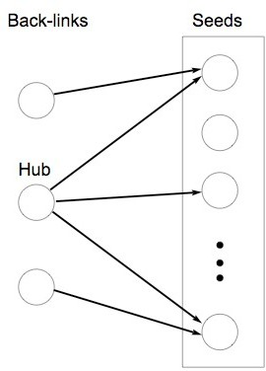
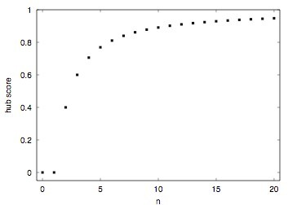
Co-citation: hub scores
Link score_{hub} = linear combination between link and hub score
Number of seeds linked from page

Slide 68
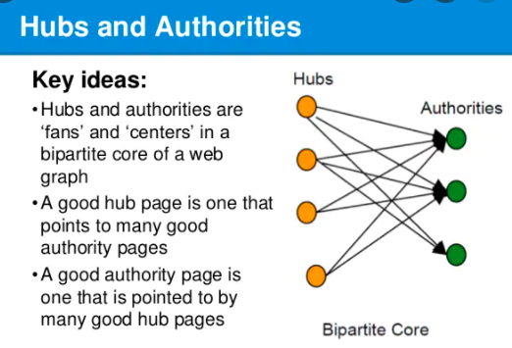

Slide 69
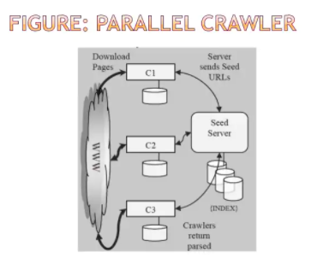

Slide 70
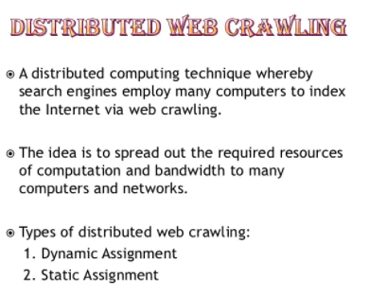

Slide 71
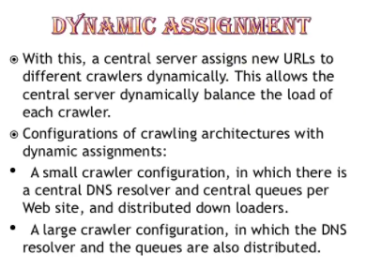

Slide 72
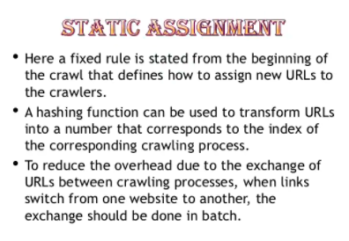

Slide 73
Outline
•
•
•
•
•
•
•
Motivation and taxonomy of crawlers Basic crawlers and implementation issues Universal crawlers
Preferential (focused and topical) crawlers Evaluation of preferential crawlers Crawler ethics and conflicts
New developments: social, collaborative, federated crawlers

Slide 74
Evaluation of topical crawlers
•
•
Goal: build “better” crawlers to support applications (Srinivasan & al. 2005)
Build an unbiased evaluation framework
–
–
–
Define common tasks of measurable difficulty Identify topics, relevant targets
Identify appropriate performance measures
Effectiveness: quality of crawler pages, order, etc.
Efficiency: separate CPU & memory of crawler algorithms from bandwidth & common utilities

Slide 75
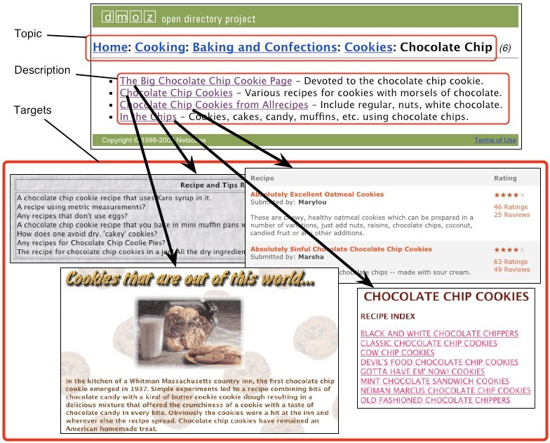
Evaluation corpus = Web
•
Automate evaluation using edited directories
•
Different sources of relevance assessments

Slide 76
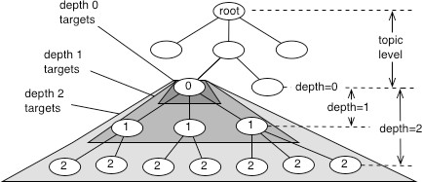
Topics and Targets
topic level ~ specificity depth ~ generality

Slide 77
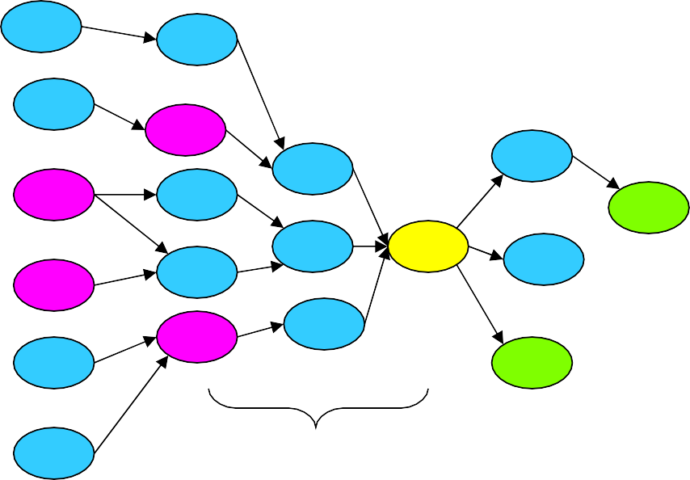
Tasks
Start from seeds, find targets and/or pages similar to target descriptions
d=2
d=3
Back-crawl from targets to get seeds

Slide 78
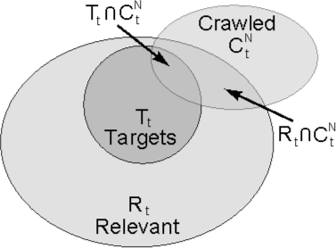
Target based performance measures
Q: What assumption are we making?
A: Independence!…

Slide 79
Outline
•
•
•
•
•
•
•
Motivation and taxonomy of crawlers Basic crawlers and implementation issues Universal crawlers
Preferential (focused and topical) crawlers Evaluation of preferential crawlers Crawler ethics and conflicts
New developments: social, collaborative, federated crawlers

Slide 80
Crawler ethics and conflicts
Crawlers can cause trouble, even unwillingly, if not properly designed to be “polite” and “ethical”
For example, sending too many requests in rapid succession to a single server can amount to a Denial of Service (DoS) attack!
Server administrator and users will be upset
Crawler developer/admin IP address may be blacklisted

Slide 81
Crawler etiquette (important!)
•
Identify yourself
–
–
–
Use ‘User-Agent’ HTTP header to identify crawler, website with description of crawler and contact information for crawler developer
Use ‘From’ HTTP header to specify crawler developer email
Do not disguise crawler as a browser by using their ‘User-Agent’ string
•
•
Always check that HTTP requests are successful, and in case of error, use HTTP error code to determine and immediately address problem
Pay attention to anything that may lead to too many requests to any one server, even unwillingly, e.g.:
–
–
redirection loops spider traps

Slide 82
Crawler etiquette (important!)
•
Spread the load, do not overwhelm a server
– Make sure that no more than some max. number of requests to any single server per unit time, say < 1/second
Honor the Robot Exclusion Protocol
•
A server can specify which parts of its document tree any crawler is or is not allowed to crawl by a file named ‘robots.txt’ placed in the HTTP root directory, e.g. http://www.indiana.edu/robots.txt
Crawler should always check, parse, and obey this file before sending any requests to a server
More info at:
http://www.google.com/robots.txt
http://www.robotstxt.org/wc/exclusion.html
–
–

Slide 83
More on robot exclusion
Make sure URLs are canonical before checking against robots.txt
Avoid fetching robots.txt for each request to a server by caching its policy as relevant to this crawler
Let’s look at some examples to understand the protocol…

Slide 84
www.apple.com/robots.txt
# robots.txt for http://www.apple.com/
User-agent: * Disallow:
All crawlers…
…can go anywhere!

Slide 85
www.microsoft.com/robots.txt
# Robots.txt file for http://www.microsoft.com
All crawlers…
User-agent: *
Disallow: /canada/Library/mnp/2/aspx/ Disallow: /communities/bin.aspx Disallow: /communities/eventdetails.mspx
Disallow: /communities/blogs/PortalResults.mspx Disallow: /communities/rss.aspx
Disallow: /downloads/Browse.aspx Disallow: /downloads/info.aspx
Disallow: /france/formation/centres/planning.asp
Disallow: /france/mnp_utility.mspx Disallow: /germany/library/images/mnp/ Disallow: /germany/mnp_utility.mspx Disallow: /ie/ie40/
Disallow: /info/customerror.htm Disallow: /info/smart404.asp Disallow: /intlkb/
Disallow: /isapi/ #etc…
…are not
allowed in
these paths…

Slide 86
www.springer.com/robots.txt
# Robots.txt for http://www.springer.com (fragment)
User-agent: Googlebot Disallow: /chl/* Disallow: /uk/* Disallow: /italy/* Disallow: /france/*
Google crawler is
allowed everywhere
except these paths
User-agent: slurp Disallow:
Crawl-delay: 2
Yahoo and
MSN/Windows Live
are allowed
User-agent: MSNBot Disallow:
Crawl-delay: 2
everywhere but
should slow down
User-agent: scooter Disallow:
AltaVista has no limits
# all others User-agent: * Disallow: /
Everyone else keep off!

Slide 87
More crawler ethics issues
Is compliance with robot exclusion a matter of law?
No! Compliance is voluntary, but if you do not comply, you may be blocked
Someone (unsuccessfully) sued Internet Archive over a robots.txt related issue
Some crawlers disguise themselves
Using false User-Agent
Randomizing access frequency to look like a human/browser
Example: click fraud for ads

Slide 88
More crawler ethics issues
Servers can disguise themselves, too
Cloaking: present different content based on User- Agent
E.g. stuff keywords on version of page shown to search engine crawler
Search engines do not look kindly on this type of “spamdexing” and remove from their index sites that perform such abuse
Case of bmw.de made the news

Slide 89
Gray areas for crawler ethics
If you write a crawler that unwillingly follows links to ads, are you just being careless, or are you violating terms of service, or are you violating the law by defrauding advertisers?
– Is non-compliance with Google’s robots.txt in this case equivalent to click fraud?
If you write a browser extension that performs some useful service, should you comply with robot exclusion?

Slide 90
Outline
•
•
•
•
•
•
•
Motivation and taxonomy of crawlers Basic crawlers and implementation issues Universal crawlers
Preferential (focused and topical) crawlers Evaluation of preferential crawlers Crawler ethics and conflicts
New developments

Slide 91
New developments: social, collaborative, federated crawlers
Idea: go beyond the “one-fits-all” model of centralized search engines
Extend the search task to anyone, and distribute the crawling task
Each search engine is a peer agent
Agents collaborate by routing queries and results

Slide 92
Need crawling code?
•
Reference C implementation of HTTP, HTML parsing, etc
– w3c-libwww package from World-Wide Web Consortium: www.w3c.org/Library/
LWP (Perl)
•
–
–
http://www.oreilly.com/catalog/perllwp/ http://search.cpan.org/~gaas/libwww-perl-5.804/
•
Open source crawlers/search engines
–
–
–
–
Nutch: http://www.nutch.org/ (Jakarta Lucene: jakarta.apache.org/lucene/) Heretrix: http://crawler.archive.org/
WIRE: http://www.cwr.cl/projects/WIRE/ Terrier: http://ir.dcs.gla.ac.uk/terrier/
•
Open source topical crawlers, Best-First-N (Java)
– http://informatics.indiana.edu/fil/IS/JavaCrawlers/
•
Evaluation framework for topical crawlers (Perl)
– http://informatics.indiana.edu/fil/IS/Framework/

